Slide 1
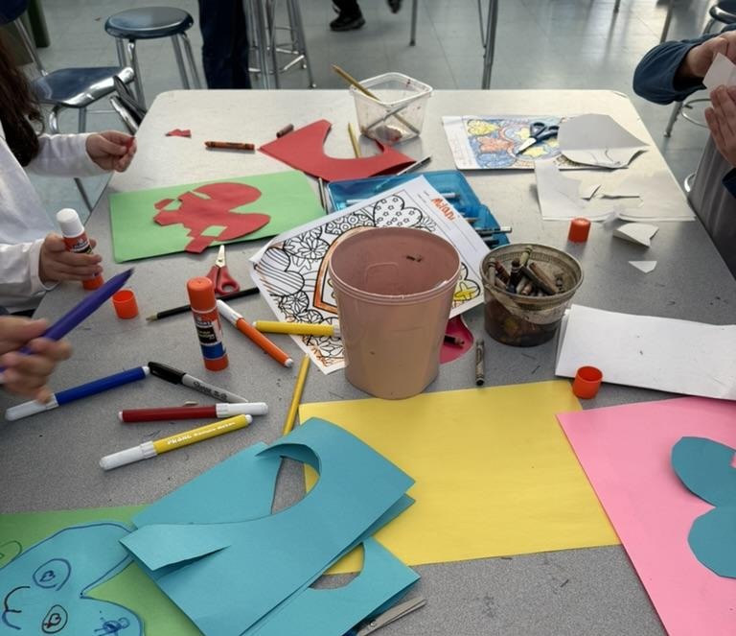
Student Examples of Self Portrait Paper Collage
By Julia Peterson

Slide 2
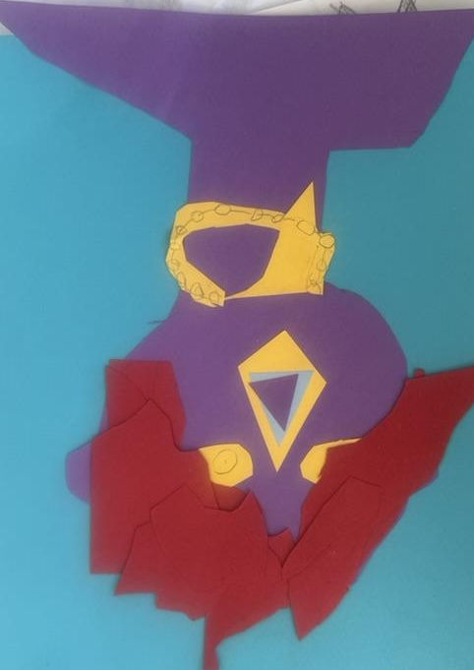
1st Grade, work in progress

Slide 3
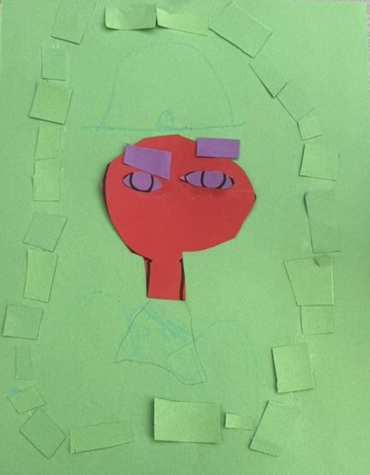
2nd Grade, work in progress

Slide 4
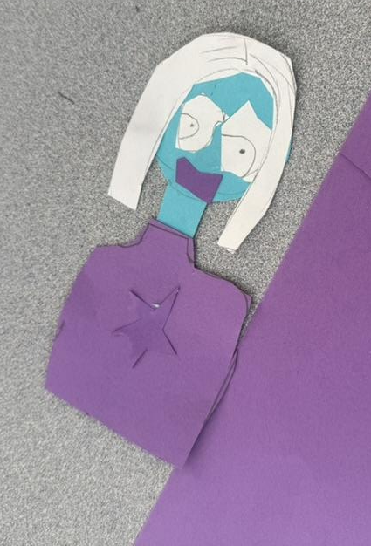
3rd Grade, work in progress

Slide 5
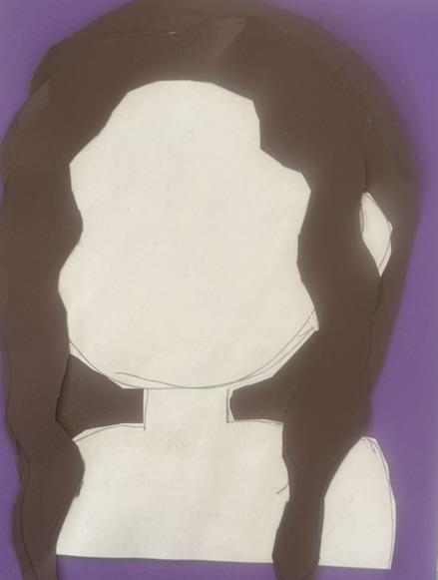
4th Grade, work in progress

Slide 6
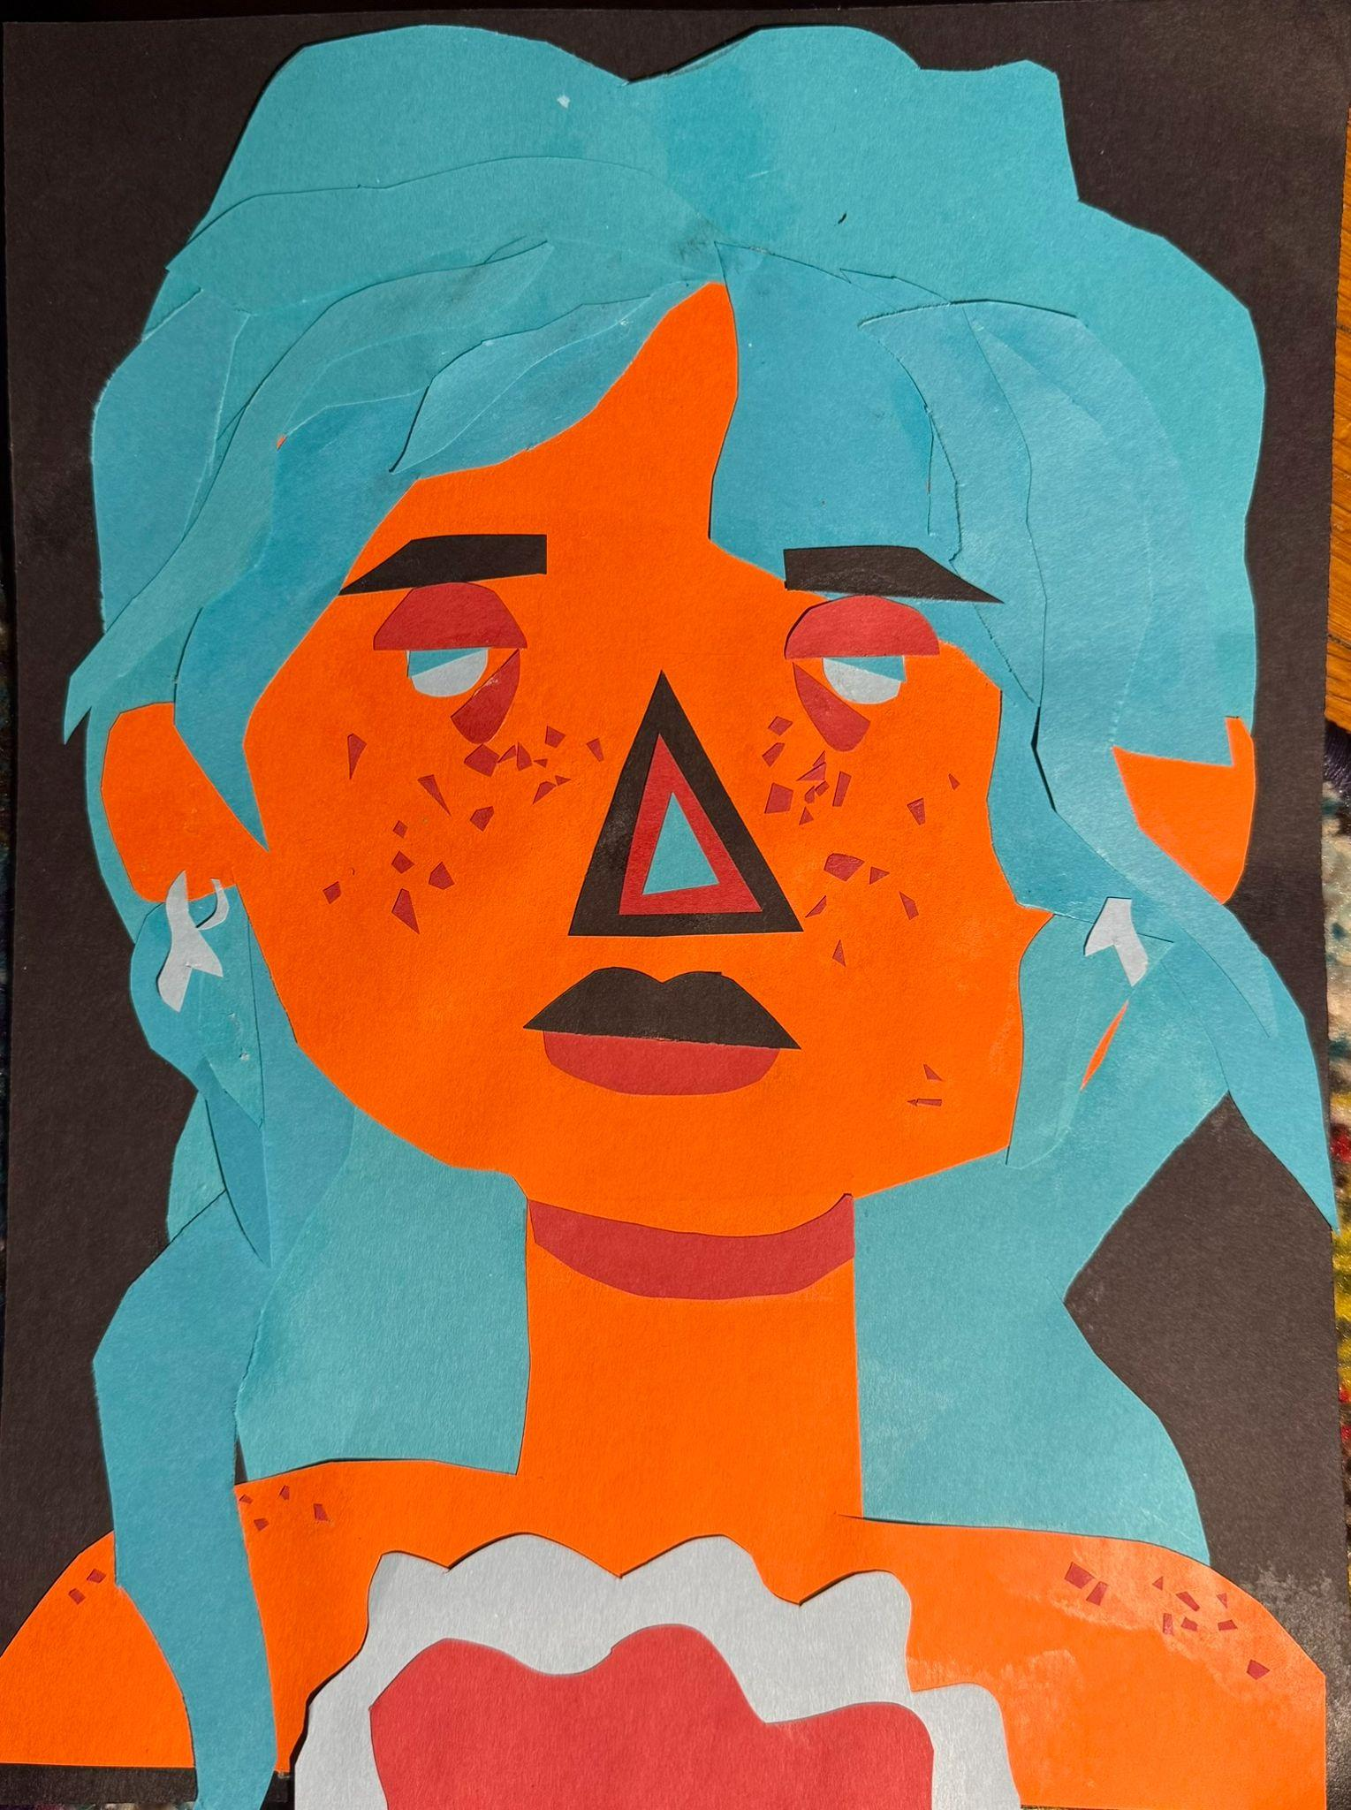
5th Grade, completed work, staff assisted

Slide 7
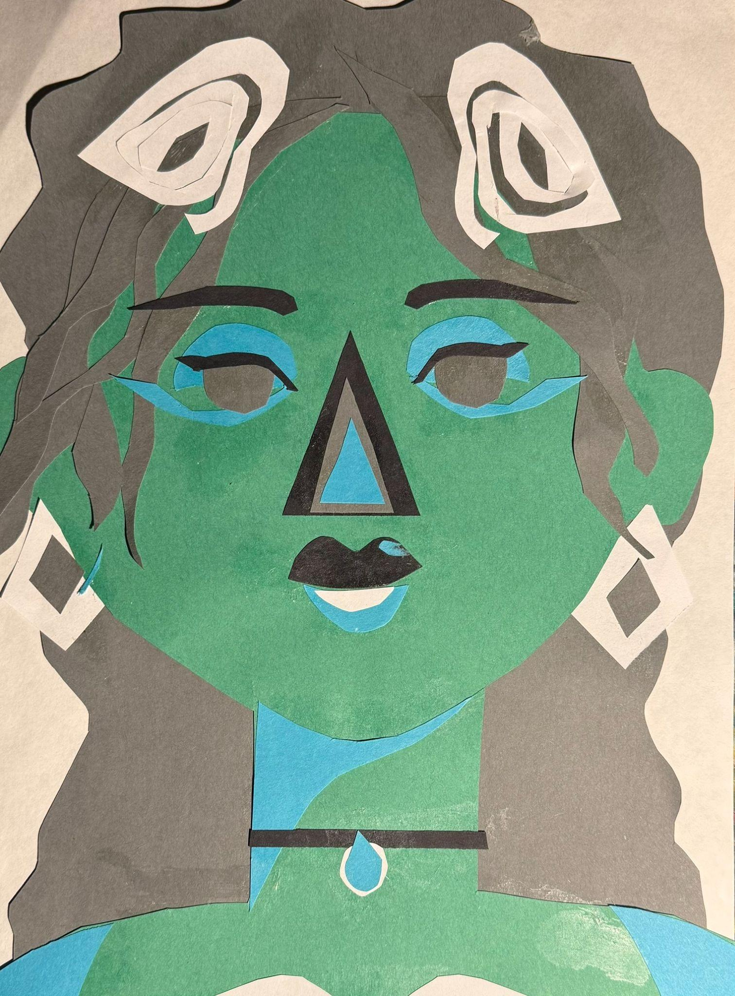
5th Grade, completed work, staff assisted

Slide 8
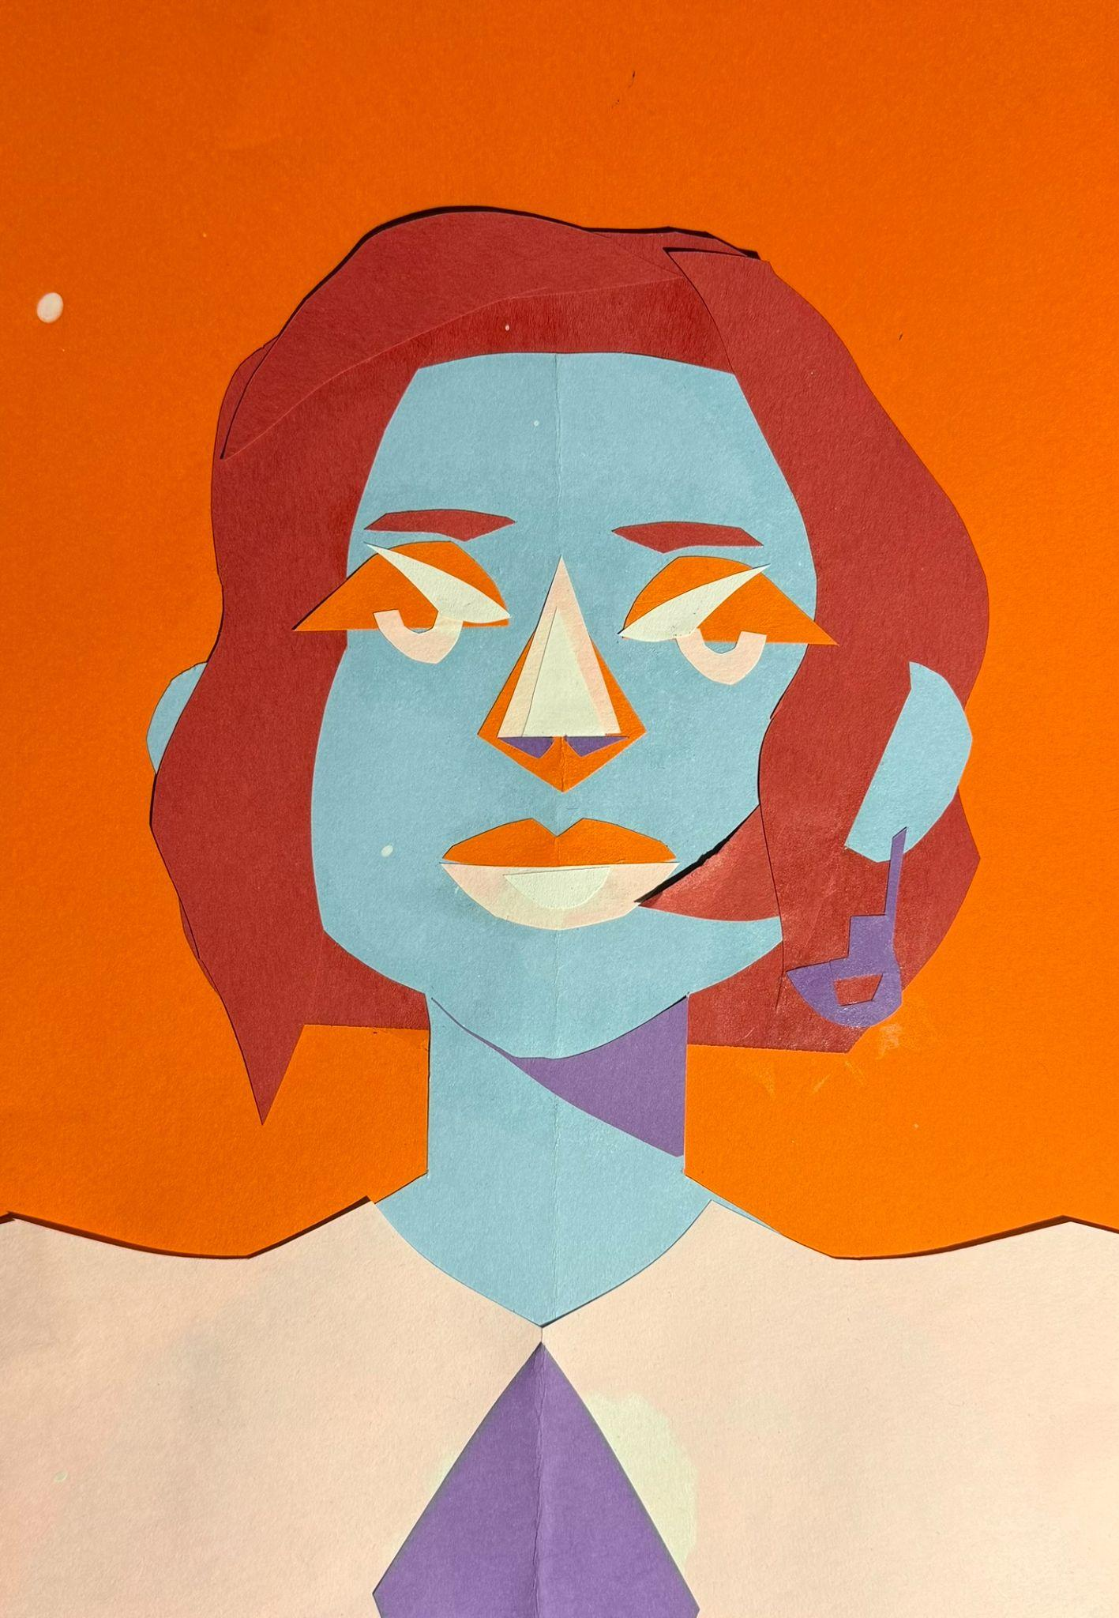
5th Grade, completed work, staff assisted

Slide 9
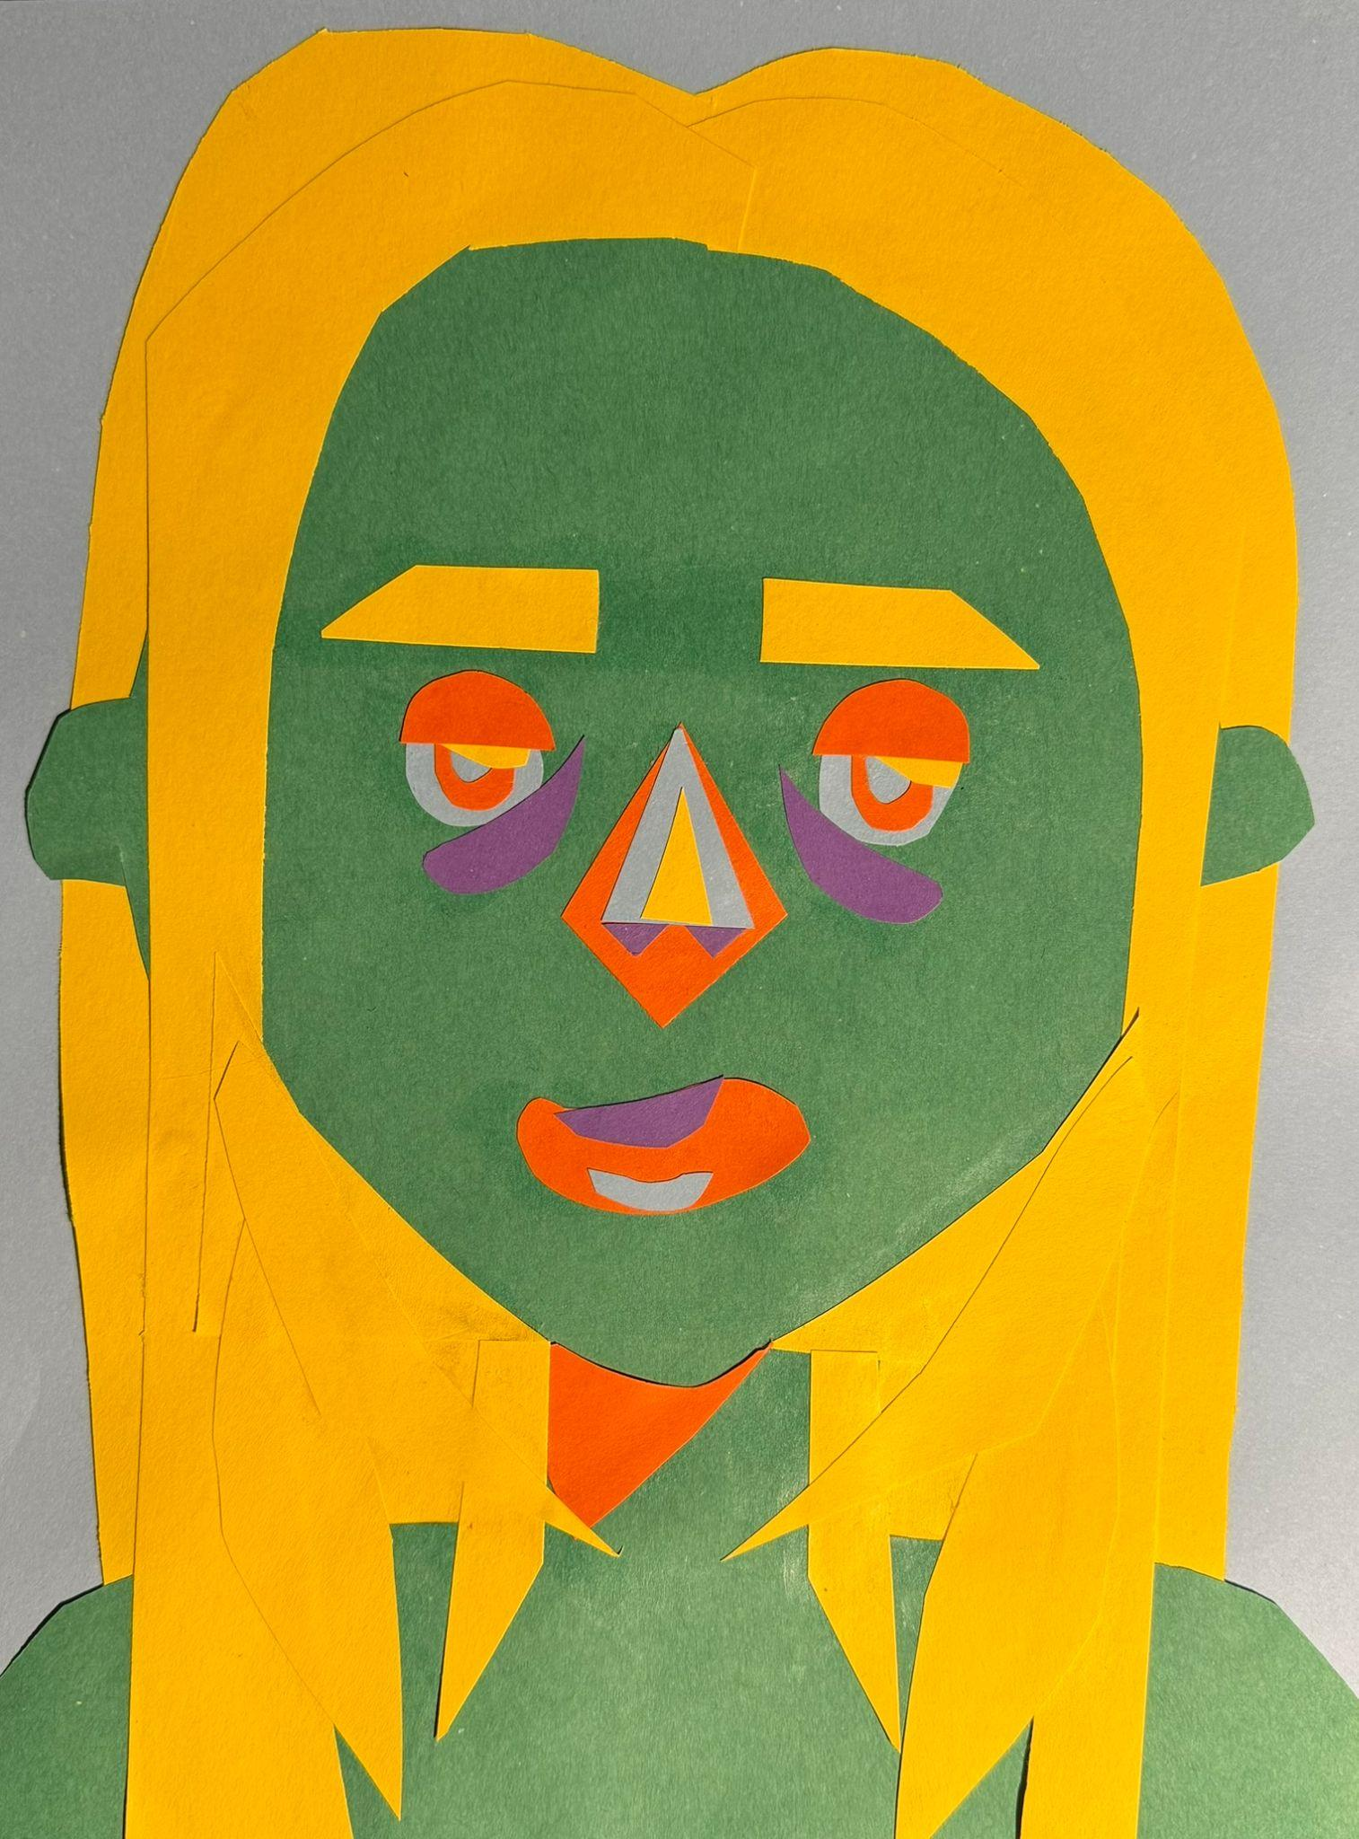
5th Grade, completed work, staff assisted

Slide 10
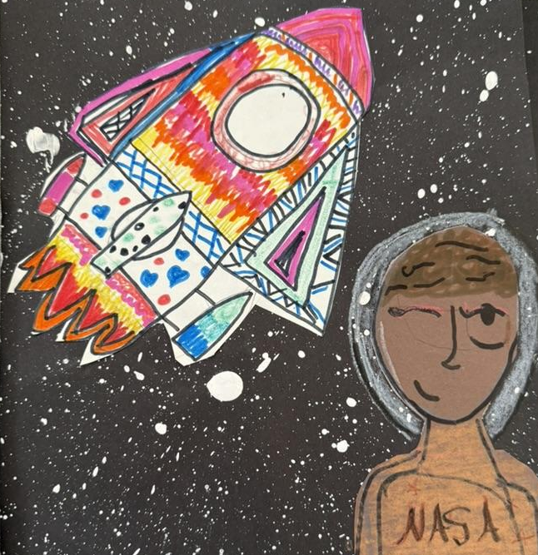
5th Grade, adapted lesson - sensory issues so we minimized paper cutting

Slide 11
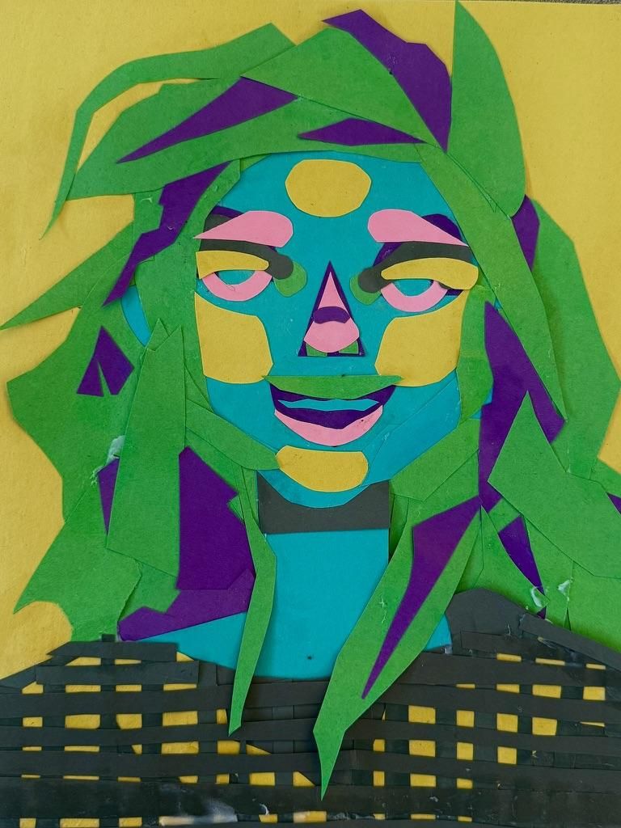
Teacher example

Slide 12
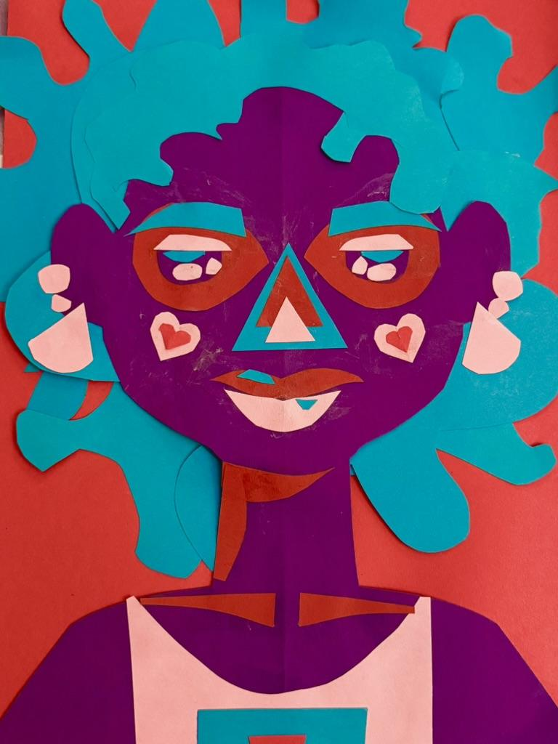
Teacher example

Slide 13
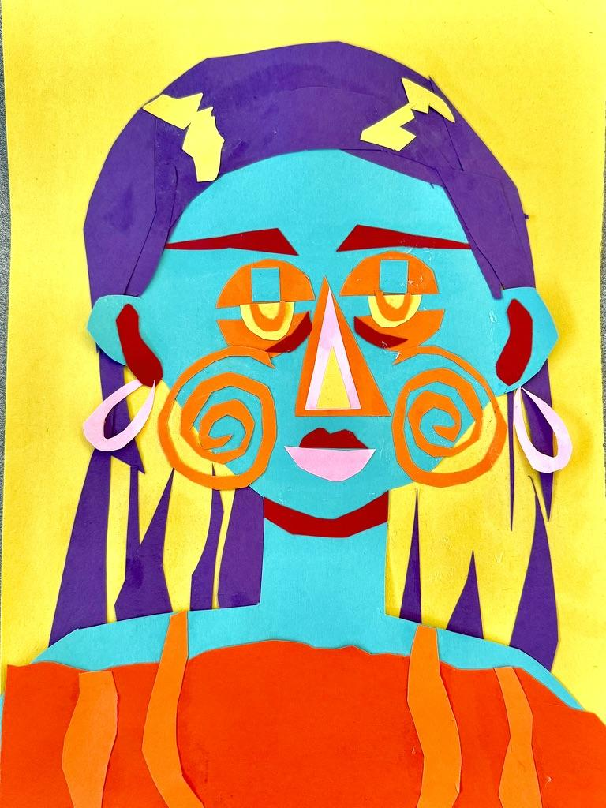
Teacher example

Slide 14
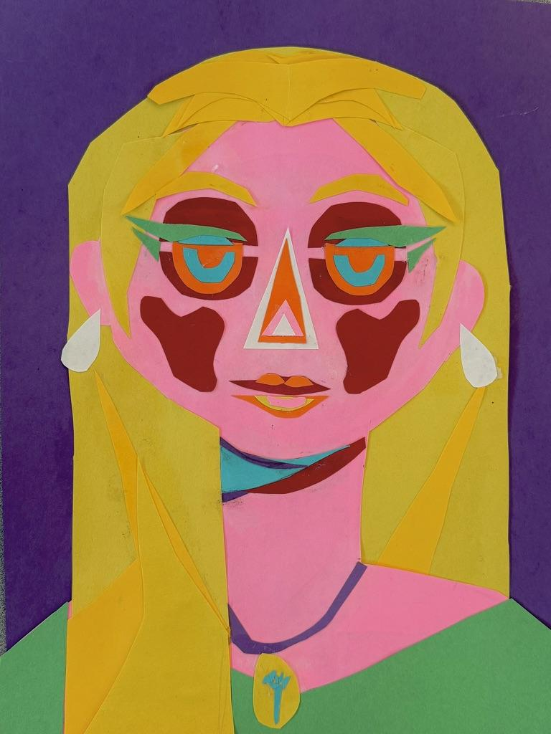
Teacher example

Slide 15
Students are still actively creating their works of art. More images will be uploaded by June 2nd.

