Slide 1
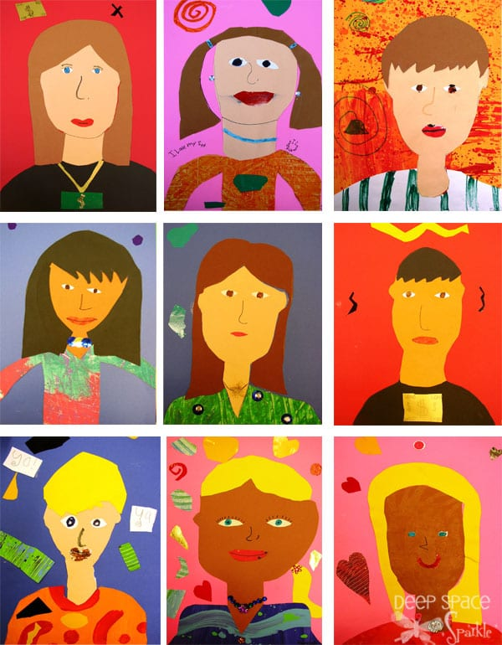
Original Contribution:Self Portrait Paper Collage
Julia Peterson
Department of Teaching and Learning, American College of Education
TEL5091 - Capstone Experience for Teaching English Learners
Professor Charlotte Williams
May 10, 2026

Slide 2

This is the first slide as students come
This is always the same (routine)
Entró al salón con calma.
Me siento en mi asiento.
Tengo la vista puesta en el maestro.
Mi voz está apagada; estoy concentrado en las instrucciones.
Come in the room calmly
Sit in seat
Eyes on the teacher
My voice is off I am focused on directions

Slide 3
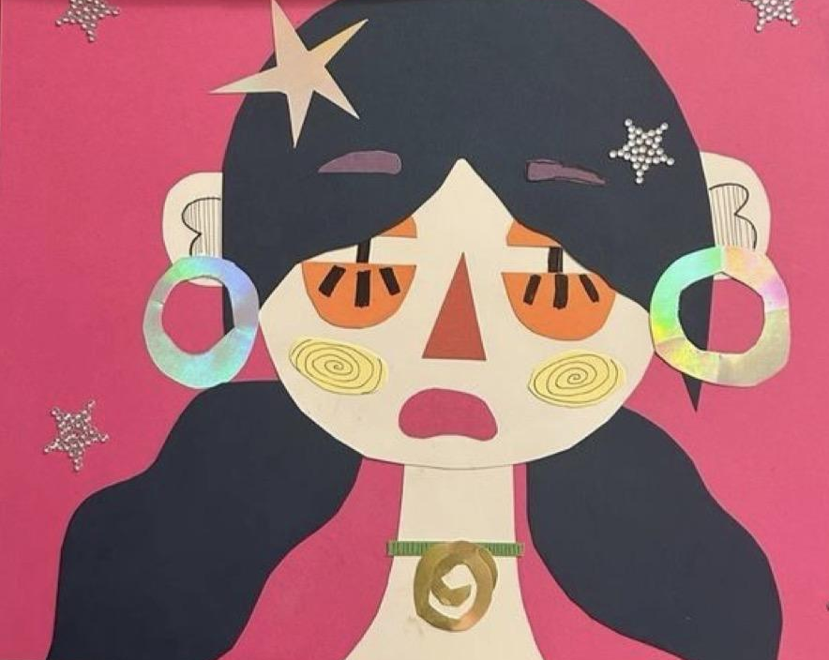
Self Portrait paper Collage
We will plan and create a self-portrait (autorretrato) using paper collage (collage de papel).
By Julia Peterson
Notes:
I can… (Yo puedo…)
I can draw my face (dibujar mi cara)
I can choose colors (elegir colores)
I can create with shapes (crear con formas)

Slide 4
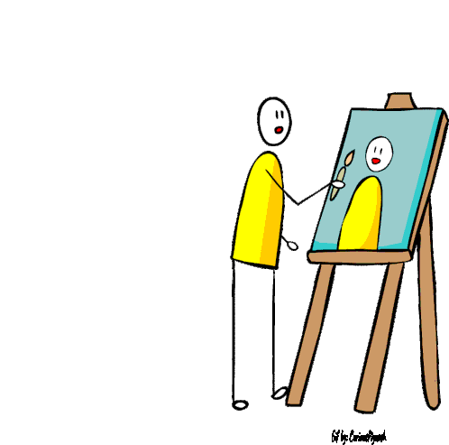
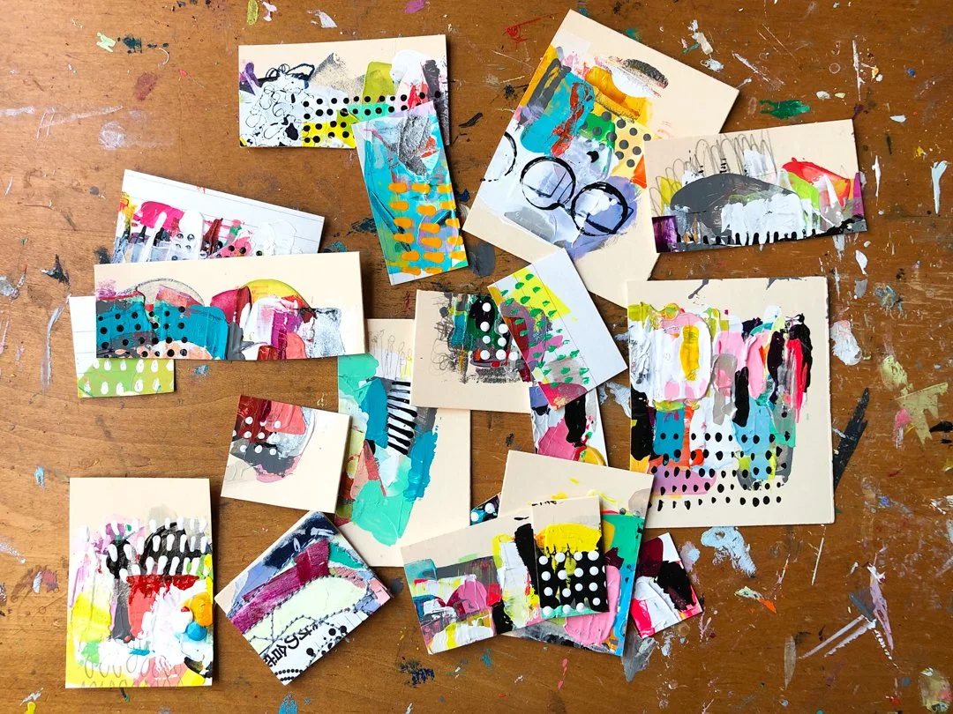

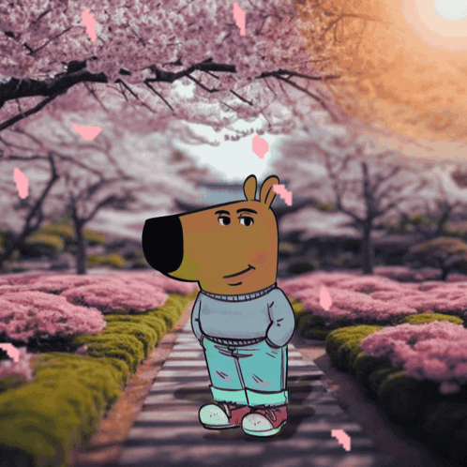
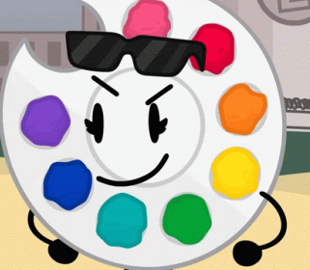
Vocabulary list
(01)
(02)
(03)
(04)
(05)
Self-portrait (autorretrato)
Collage (collage)
Shape (forma)
Background (fondo)
Color (color)

Slide 5
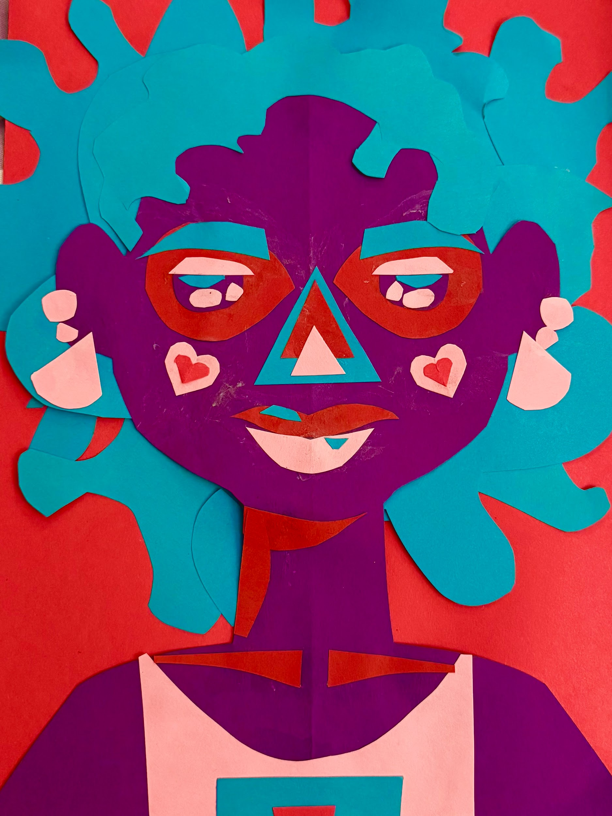
Visual Thinking Strategies (VTS) / Inquiry-Based Learning / Art Inquiry
TURN AND TALK
- What do you see? (¿Qué ves?)
I see ___
I notice ___
It is made of ___

Slide 6
Visual Thinking Strategies (VTS) / Inquiry-Based Learning / Art Inquiry
- What shapes do you see? (¿Qué formas ves?)

Slide 7
Visual Thinking Strategies (VTS) / Inquiry-Based Learning / Art Inquiry
What materials do you see? (¿Qué materiales ves?)

Slide 8
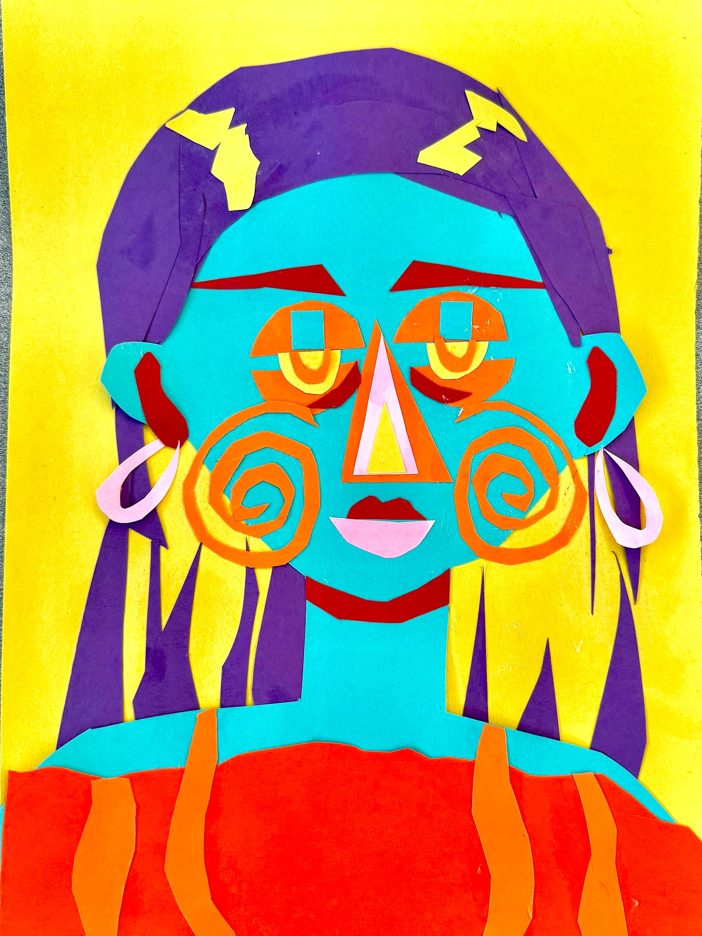
Today we will build (construir) our portrait using paper.
I can… (Yo puedo…):
- I can draw my face (dibujar mi cara)
- I can choose colors (elegir colores)
- I can create with shapes (crear con formas)

Slide 9
Teacher Modeling Language
Students follow along with the teacher to use I do, You do, We do!
The teacher demonstrates using the document camera
“Watch me” (Mírame)
“First, I…” (Primero, yo…)
“Next, I…” (Luego, yo…)
“Now you try” (Ahora tú intenta)

Slide 10
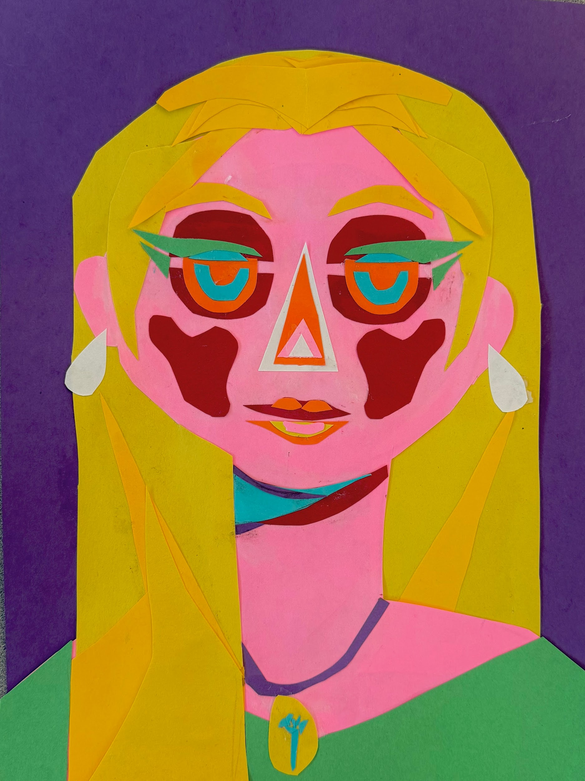

Directions
TODAY WE WILL (HOY VAMOS A):
Get your paper (recoger papel)
Cut shapes
(cortar formas)
Glue your portrait (pegar tu retrato)

Slide 11
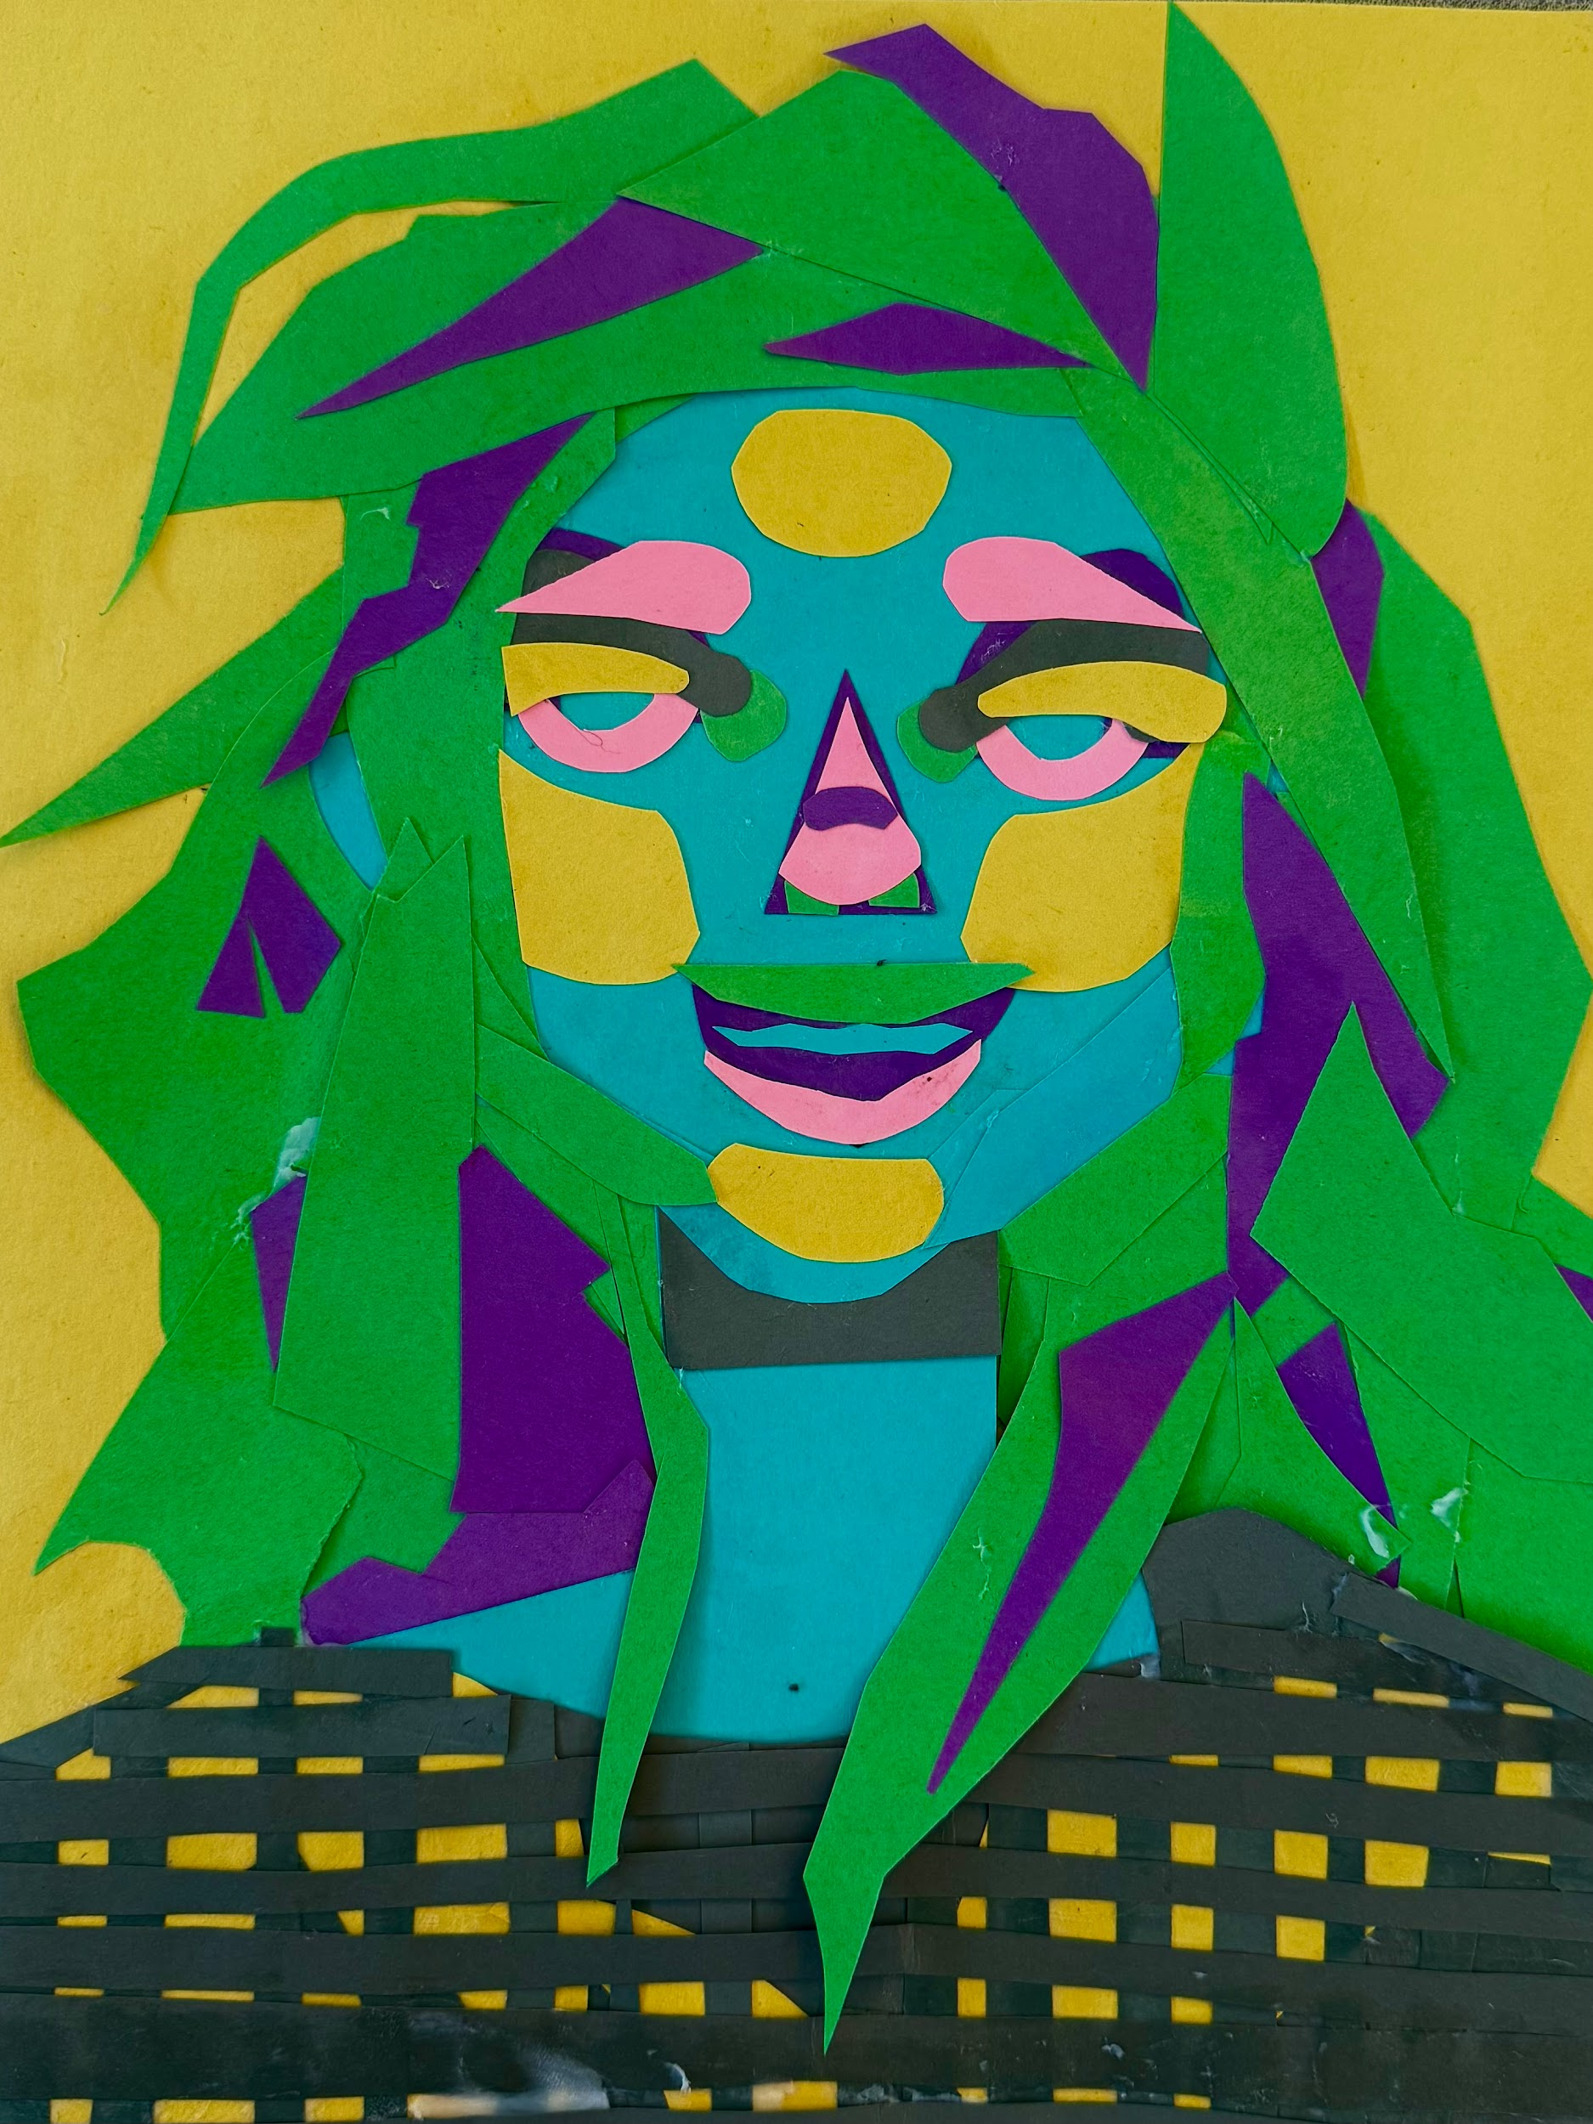
Reflection / showing art on the screen - students present their artwork
My portrait shows ___
(Mi retrato muestra ___)
I used ___ colors
(Usé ___ colores)
I feel ___ about my work
(Me siento ___ con respecto a mi trabajo)

Slide 12
clean up / limpiar
Guarden los materiales
  Tijeras, pegamento, lápices
Lávense las manos
  Hagan una fila tranquila y en silencio frente al lavabo
  Una persona a la vez en el lavabo
Siéntate
Put materials away
  Scissors, glue, pencils
Wash hands
  Quiet calm line at sink
  One person at a time at a sink
Sit in seat

Slide 13
Line up when the teacher calls your table color
Pónganse en fila cuando el maestro llame al color de su mesa.

Slide 14
Thanks!
Do you have any questions?
juliajpeterson@gmail.com
https://www.juliapetersonsart.com/
www.linkedin.com/in/julia-peterson-40aaa3343
https://www.instagram.com/an_attempt_to_art/?hl=en
By Julia Peterson

